Slide 1
Jenkins Pipeline

Slide 2
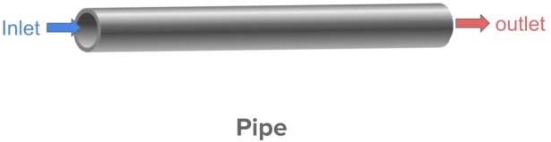
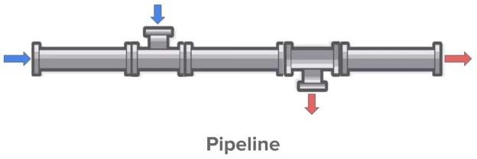
What is Pipeline?
In Jenkins, a pipeline is a group of events or jobs which are interlinked with one another in a sequence.

Slide 4
How to setup BUILD PIPELINE in Jenkins
Step1: Chain required jobs in sequence Add upstream/downstream jobs Step2: Install Build Pipeline Plugin
Step3: Add
Build Pipeline View Configure the view Step
Step4: Run and Validate

Slide 5
Demo
Sample Build Job
Sample Deploy Job
Sample Test Job
Sample Release Job

Slide 6
How to Build Pipelines with Groovy Script

Slide 7
Agenda
CI & CD
What is Jenkins Pipeline?
How many ways we can create Pipeline?
Create Jenkins Pipeline using Groovy Script / Jenkins File

Slide 8
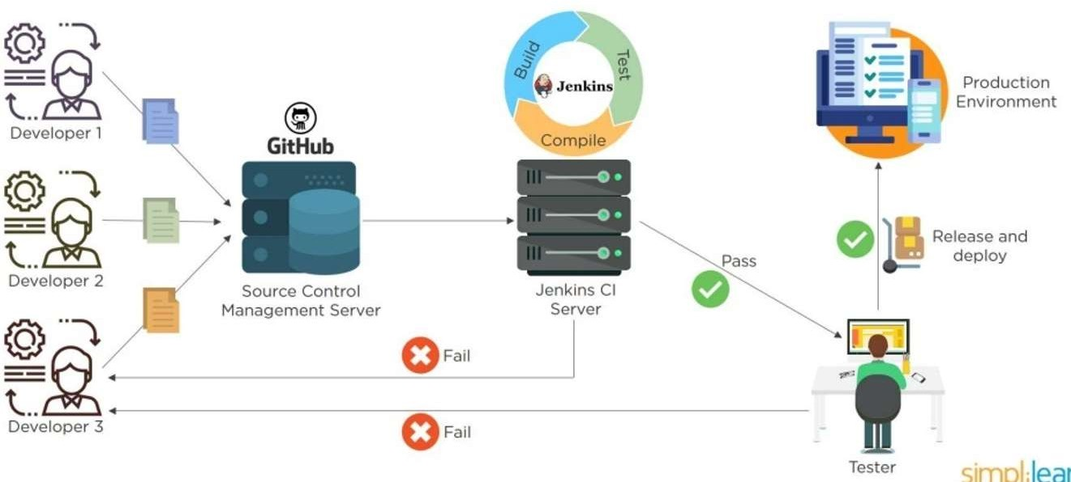
CI & CD

Slide 9
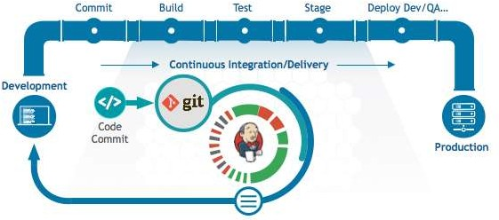
Jenkins Pipeline

Slide 10
How many Ways we can create Pipeline
We can Create Jenkins Pipeline in 2 Ways
1) Using Build And Delivery Pipeline Plugins
2) Using Groovy Script on the Fly(Here we use Jenkins file)
Scripted
Declarative

Slide 11


Build And Delivery Pipeline Plugins
Build
Deploy
Test
Release
Job1 Job2
Pipeline Job with Scripting
Job3
Job4
Build
Stage1
Groovy Scripting
Jenkins File
Deploy
Stage2
Pipeline Job
Test
Stage3
Release
Stage4

Slide 12
Types of Pipeline
Scripted Pipeline
Declarative Pipeline

Slide 13
Pipeline concepts
Pipeline
A Pipeline is a user-defined model of a CD pipeline. A Pipeline’s code defines your entire build process, which typically includes stages for building an application, testing it and then delivering it.
Also, a pipeline block is a key part of Declarative Pipeline syntax.
Node
A node is a machine which is part of the Jenkins environment and is capable of executing a Pipeline.
Also, a node block is a key part of Scripted Pipeline syntax.
Stage
A stage block defines a conceptually distinct subset of tasks performed through the entire Pipeline (e.g. "Build", "Test" and "Deploy" stages), which is used by many plugins to visualize or present Jenkins Pipeline status/progress.
Step
A single task. Fundamentally, a step tells Jenkins what to do at a particular point in time (or "step" in the process). For example, to execute the shell command make use the sh step: sh 'make'. When a plugin
extends the Pipeline DSL, that typically means the plugin has implemented a new step.

Slide 14
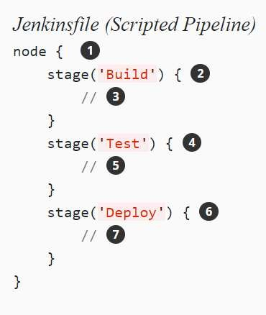
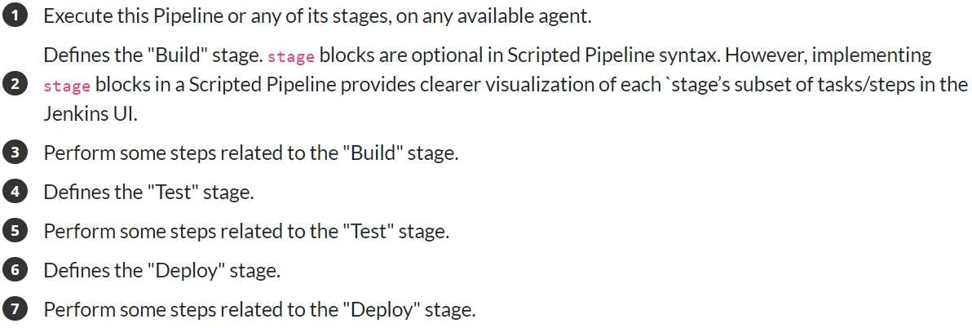
Scripted Pipeline

Slide 15
Jenkins file
Jenkinsfile is a text file that contains the definition of a Jenkins Pipeline and is checked into source control.
https://jenkins.io/doc/book/pipeline/jenkinsfile/

Slide 16
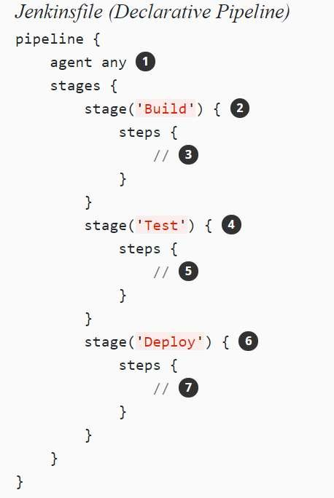
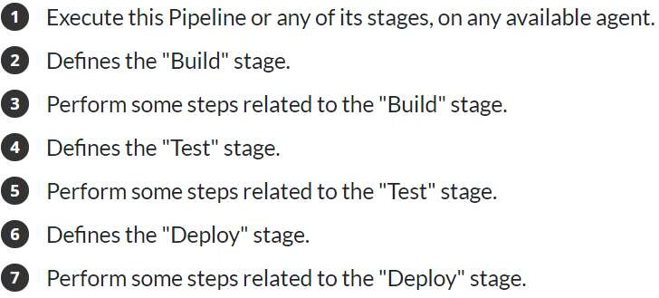
Declarative Pipeline

